Slide 1

Tableau Project: AirBnB |Case Study using Tableau
Franklin Anozie
LightHouse Labs
October 2, 2023

Slide 2

Goal:
Employing Tableau to transform data into easily understandable visual representations.
Crafting compelling dashboards that assist stakeholders in making informed decisions to tackle business inquiries and challenges.
Conveying insights effectively through appropriate visualizations.
Notes:
Using Tableau to transform data into visual representation that is easily understood
Produce compelling dashboards to assist stakeholders make informed decisions
With the right visuals convey insights

Slide 3
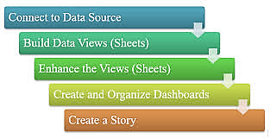

Process Flow:

Slide 4


What is Airbnb?
Airbnb is an online marketplace that connects people who want to rent out their property with people who are looking for accommodations, typically for short stays.
Airbnb offers hosts a relatively easy way to earn some income from their property.
Guests often find that Airbnb rentals are cheaper and homier than hotels.
Airbnb makes the bulk of its revenue by charging fees to both guests and hosts.
Notes:
What Is Airbnb?
Airbnb (ABNB) is an online marketplace that connects people who want to rent out their homes with people looking for accommodations in specific locales.
The company has come a long way since 2007, when its co-founders first came up with the idea to invite paying guests to sleep on an air mattress in their living room.
According to Airbnb's latest data, it now has more than 7 million listings, covering some 100,000 cities and towns in 220-plus countries and regions worldwide.
Airbnb is a contraction of "Airbed and Breakfast," an earlier name that reflected the company’s origins.

Slide 5

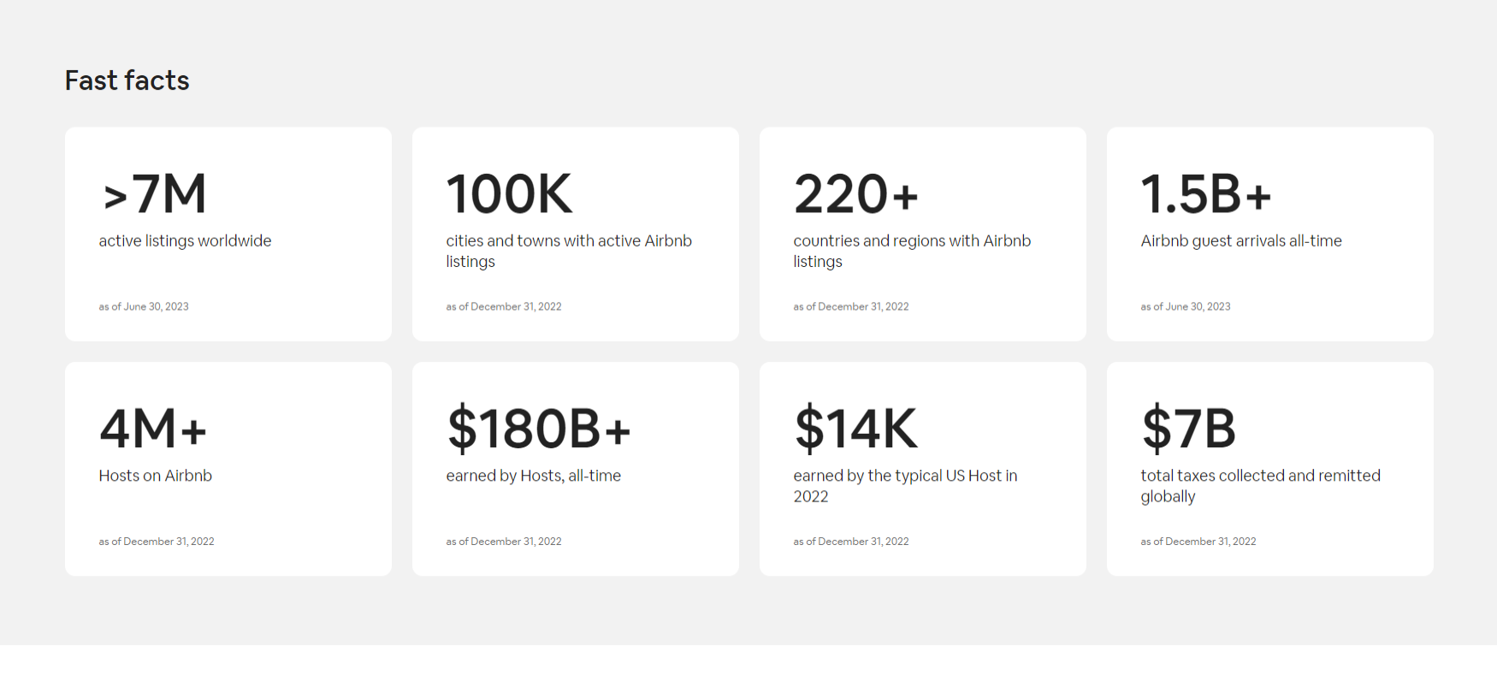
Fast Facts
Notes:
According to Airbnb's latest data, it now:
Has more than 7 million listings,
With over 4M Hosts
Covering some 100,000 cities and
Towns in 220-plus countries and regions worldwide.
Raking in over 1.5B in revenue

Slide 6
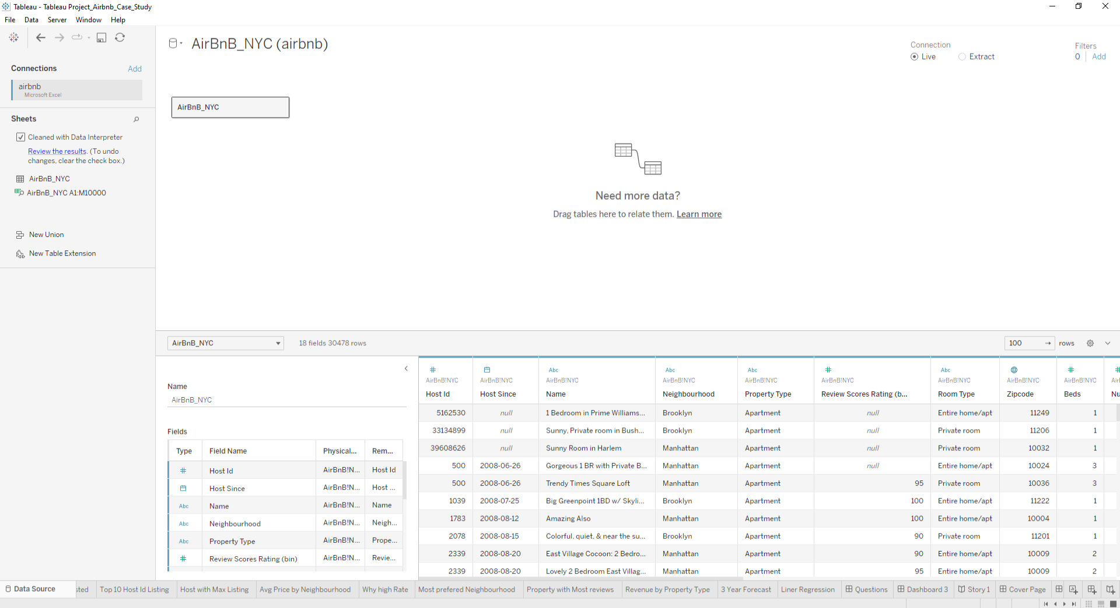
Connect to Data Source
Notes:
1. Imported an Excel file containing data into Tableau. As there was only one table, there was no requirement to establish relationships or perform table joins.
2. Conducted a dataset preview to discern the data types within each column and made note of cells containing null values.
3. The identified data types are as follows:
- 7 columns consisting of whole numbers.
- 4 columns containing string data.
- 1 column representing date information.
- 1 column containing geographic information.

Slide 7
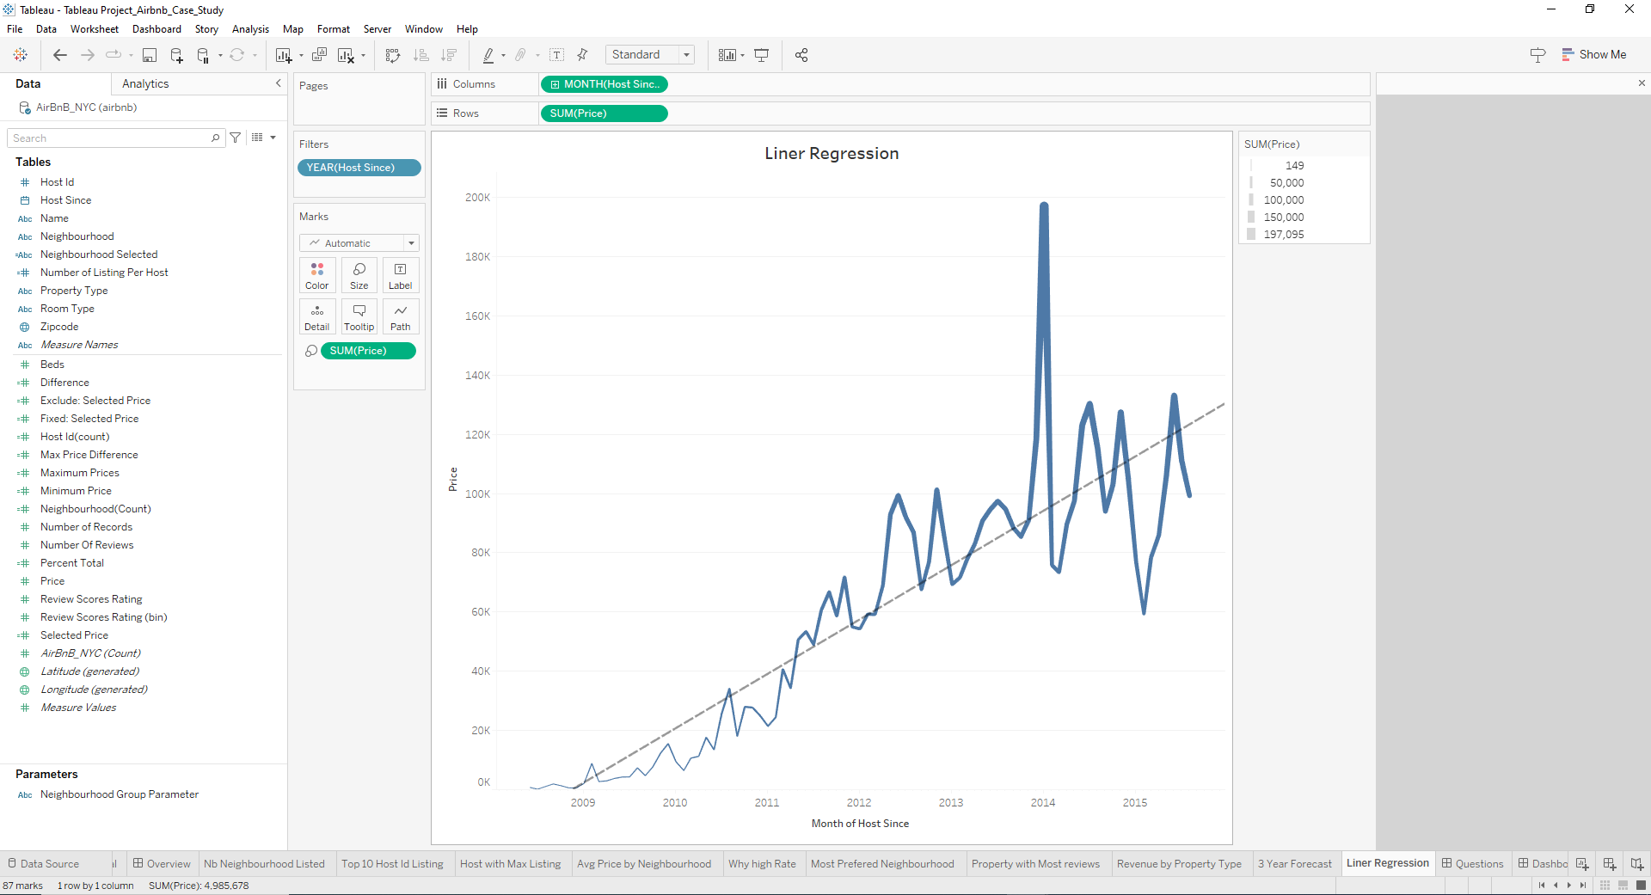
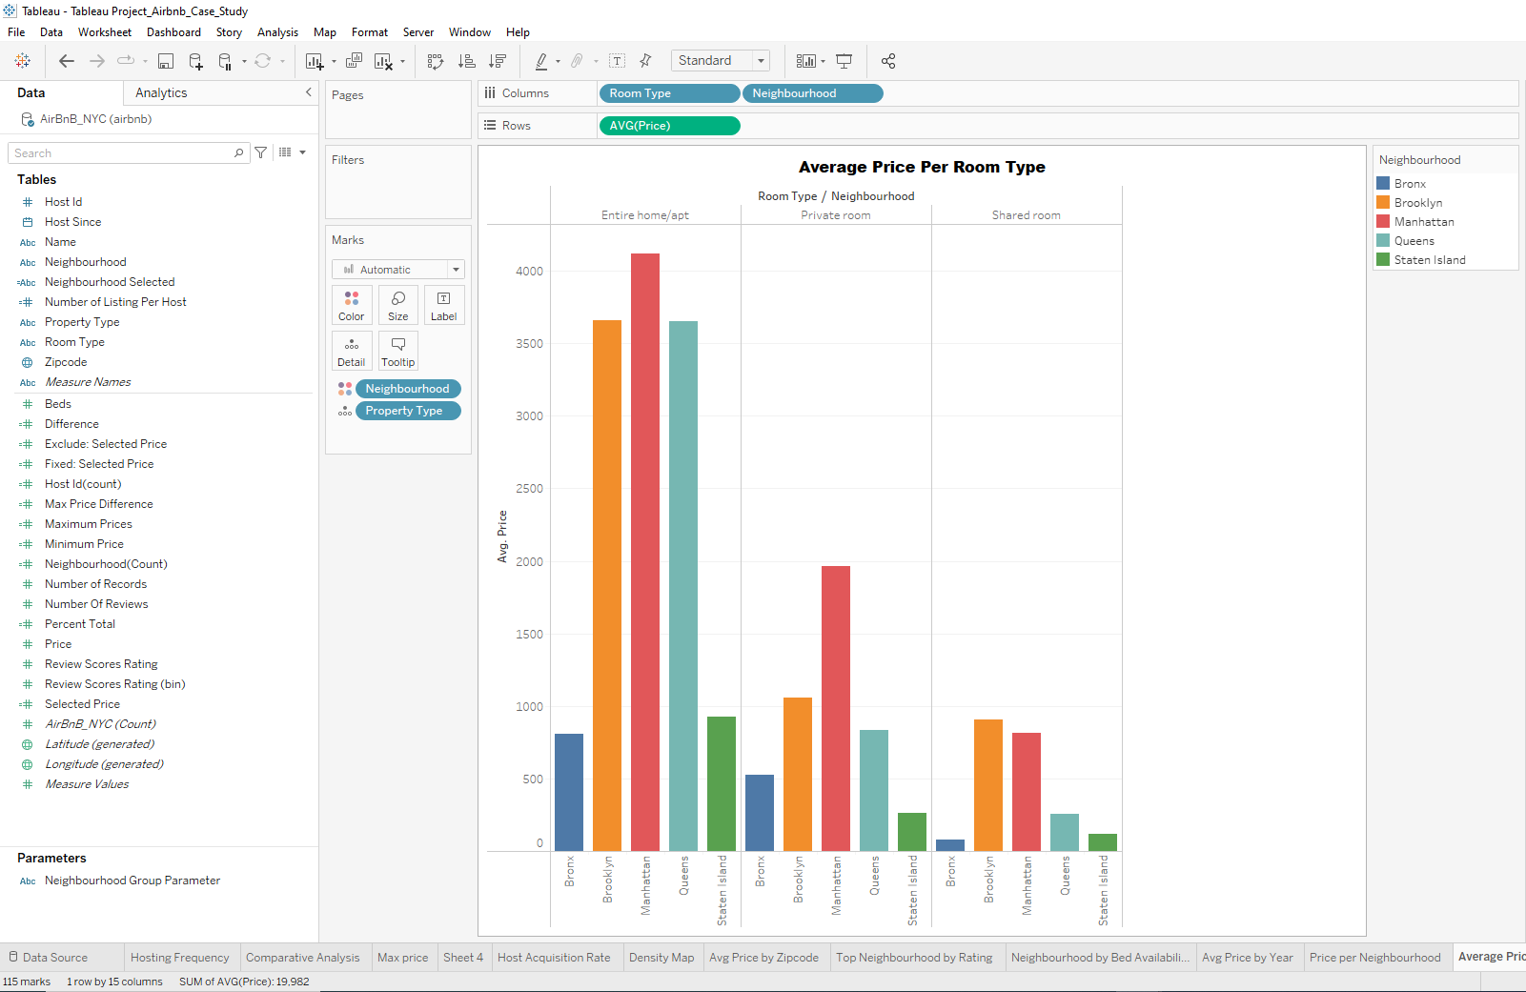
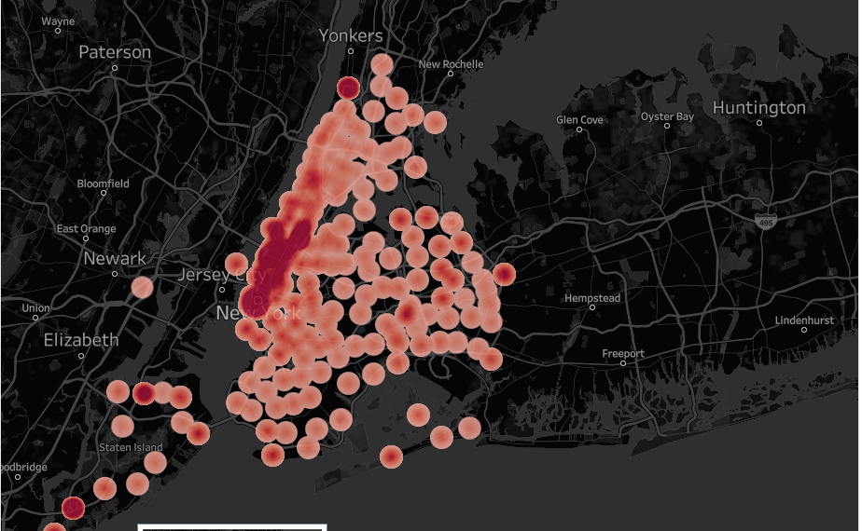
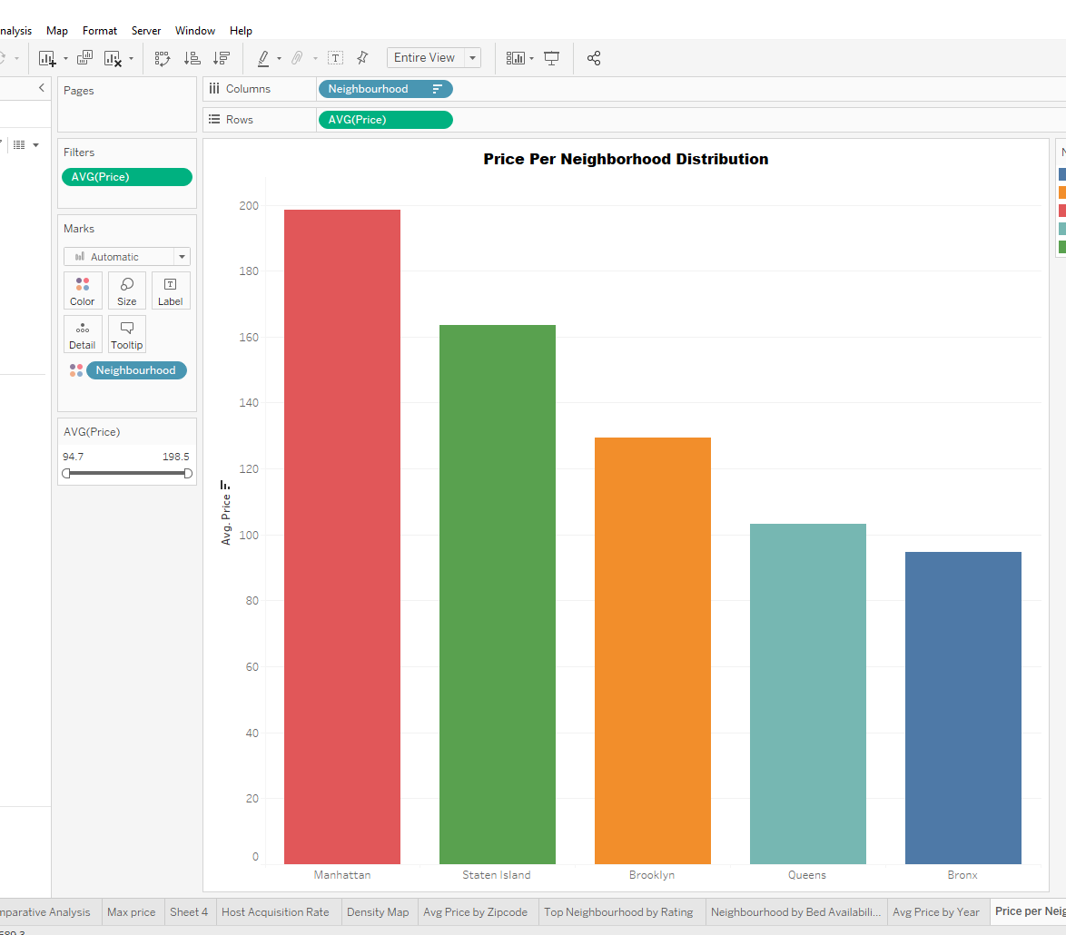
Build Data views(Sheets)
Notes:
I generated views to gain a comprehensive understanding of the data and the relationships among various variables.
Here are some insights:
Property Count by Neighborhood: This chart unveiled the presence of 5 neighborhoods - Bronx, Brooklyn, Manhattan, Queens, and Staten Island.
Notably, Manhattan boasts the highest share at 52% of available Airbnb rental properties.
2. Count of Property Types: The dataset encompasses 15 different property types, with "Apartment"
representing approximately 89% of the listings.
3. Revenue by Property Type: Among property types, "Apartment" properties contribute a significant
88% of the total revenue, spanning all neighborhoods.
4. Average Price by Room Type: There are three distinct room types - "entire home/apt," "private room,"
and "shared room." "Shared room" stands out as the most budget-friendly choice among the three.
5. Map of Airbnb Locations: Notably, some locations (ZIP Codes) extend beyond the boundaries of New
York City, presenting an anomaly within the dataset.
6. Price Over Time: Rental prices exhibited a consistent upward trend from June 2008, reaching their peak
in January 2014. A 3-year forecast indicates a continued growth trajectory, suggesting a promising outlook for the Airbnb business in NYC.

Slide 8

Kindly refer to the Tableau file for more information on building of views

Slide 9
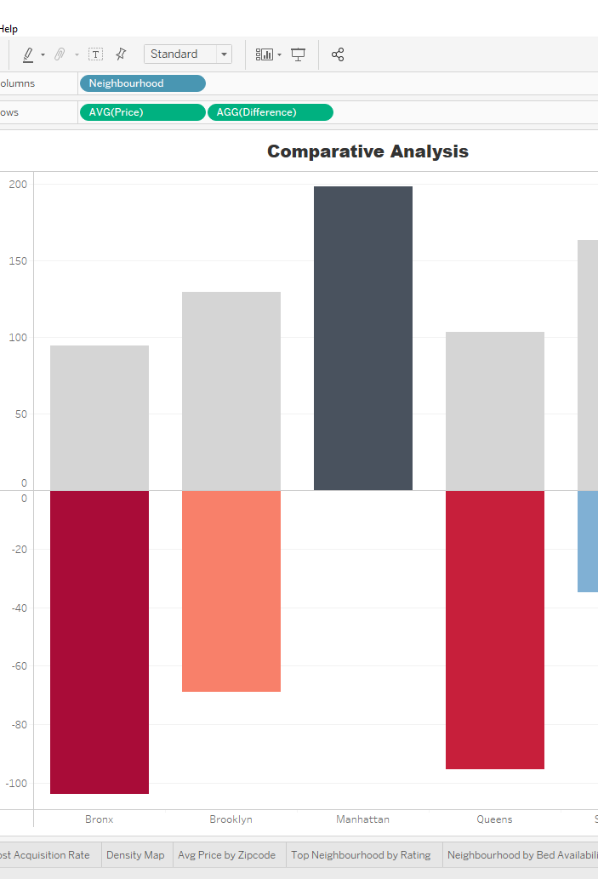
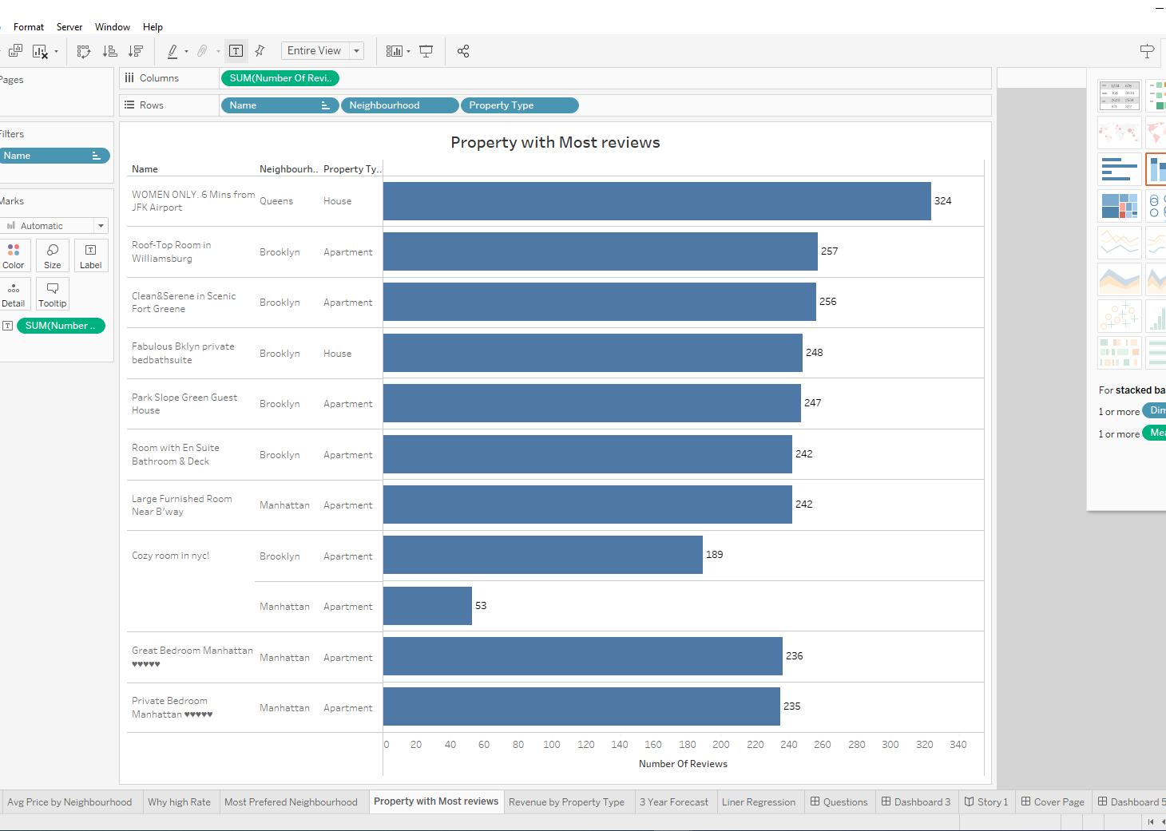
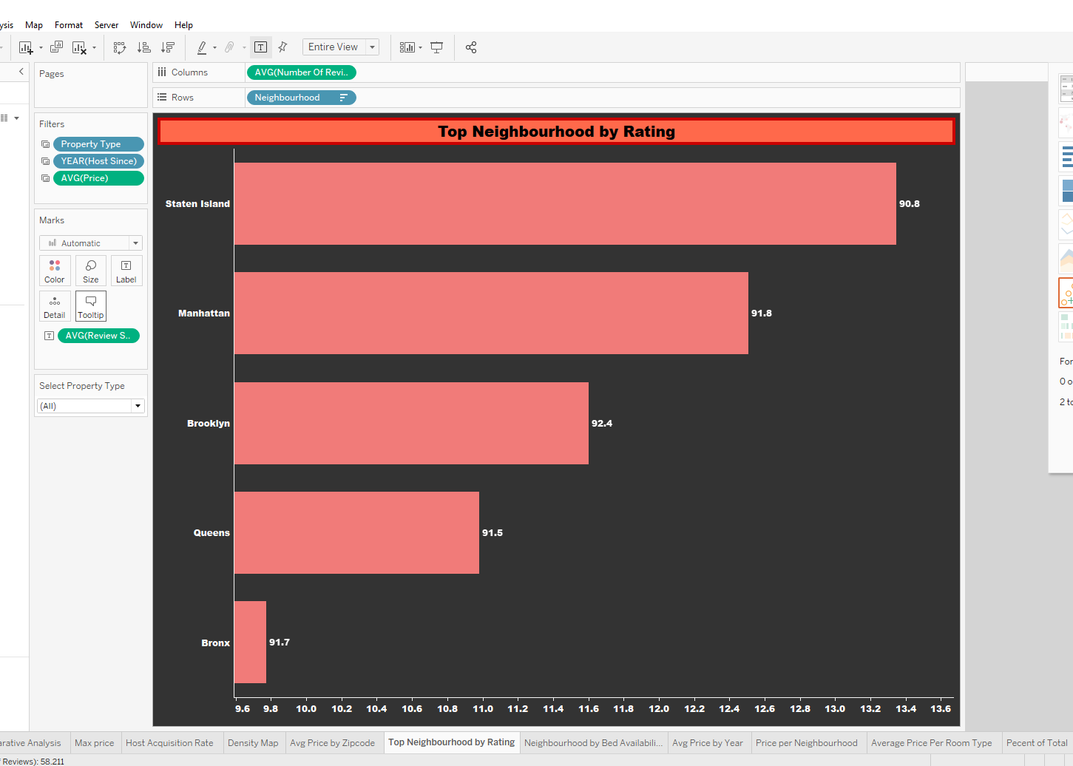
Enhance the views(Sheets)

Slide 10

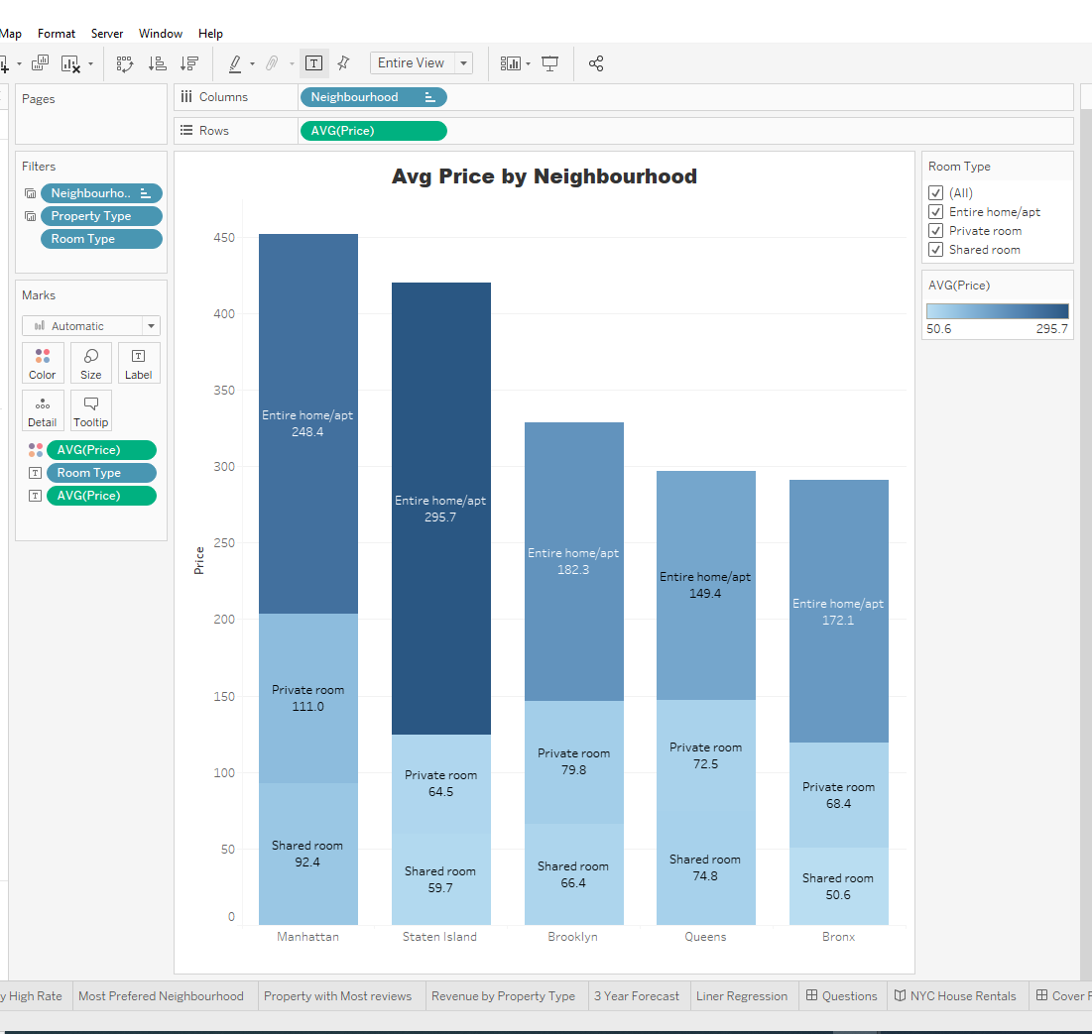
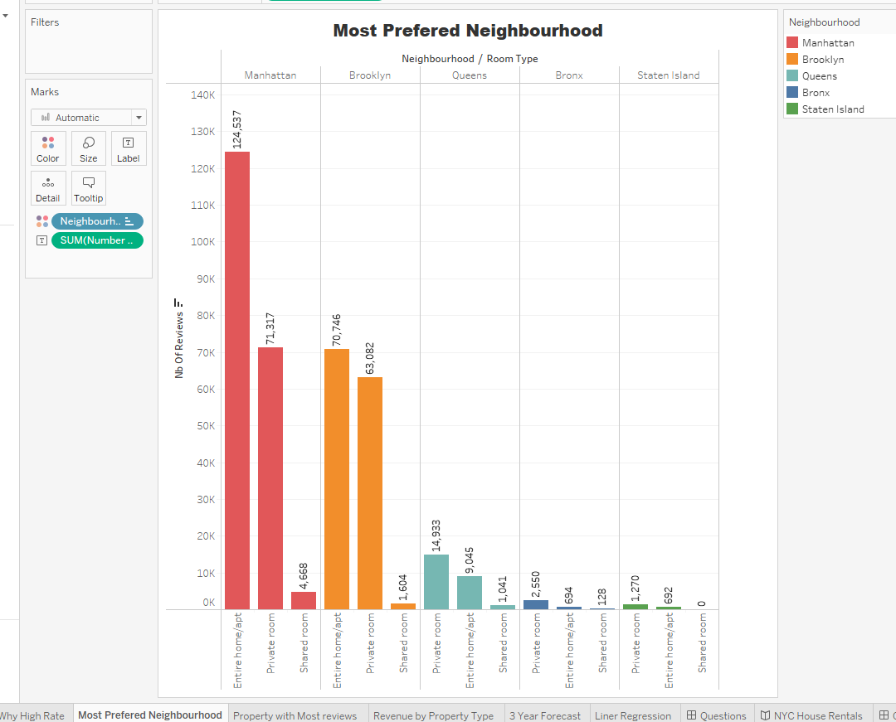
What kind of rooms are rented the most?
Based on Nb of reviews: the most preferred room type is Home/apt with total review of over 120,000
Based on Price: the most preferred is Home/apt with max avg of $295

Slide 11
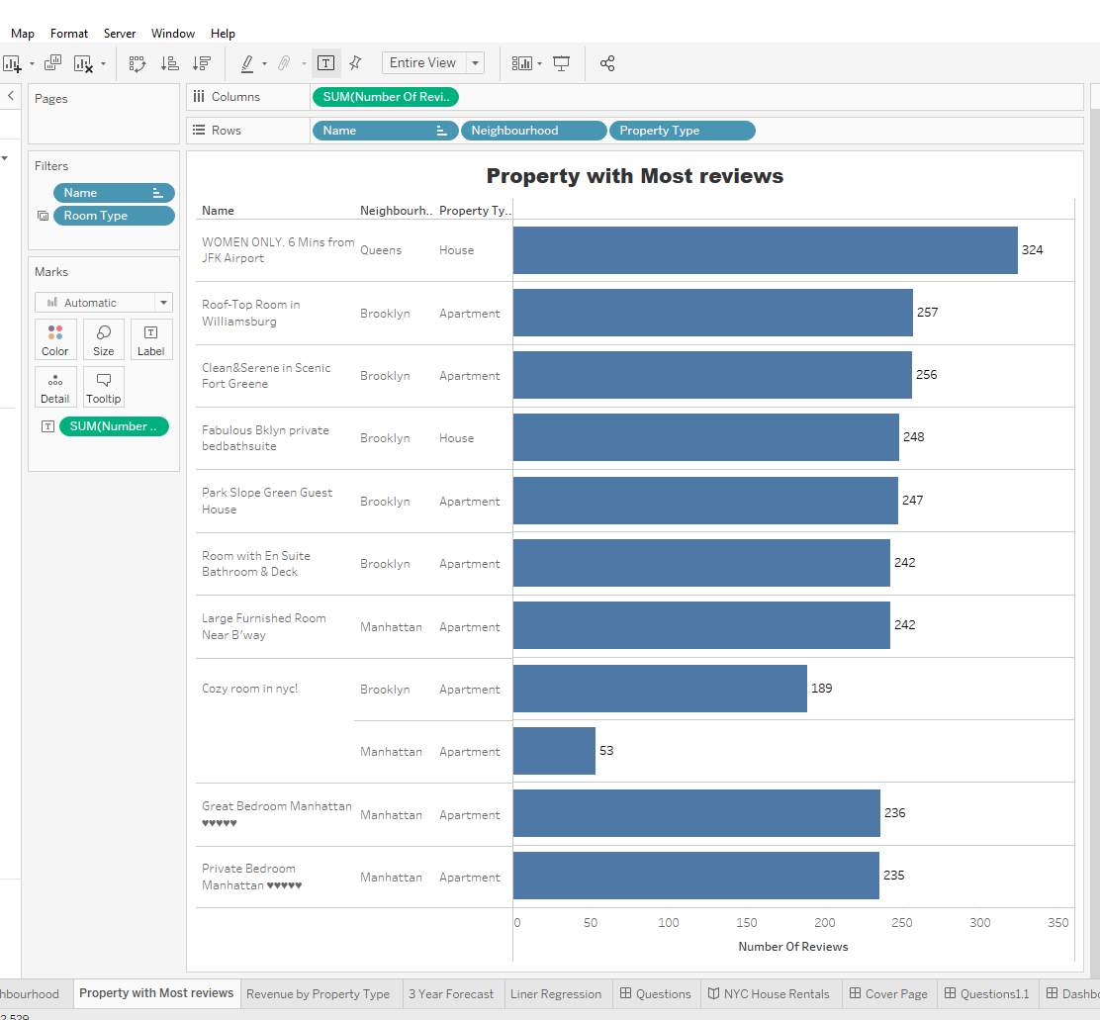
Which neighborhood is most preferred?
Based on Nb of reviews: the most preferred neighborhood is Manhattan with total review of over 120,000
Based on name/address: the most preferred is neighborhood is Queens with total review of 324

Slide 12
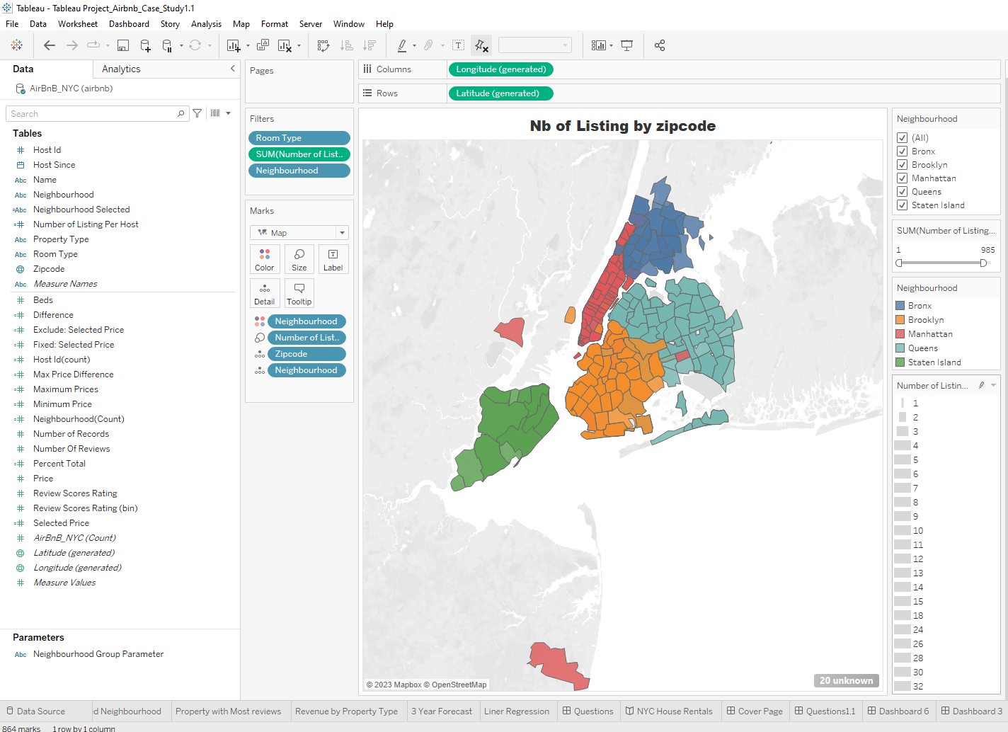
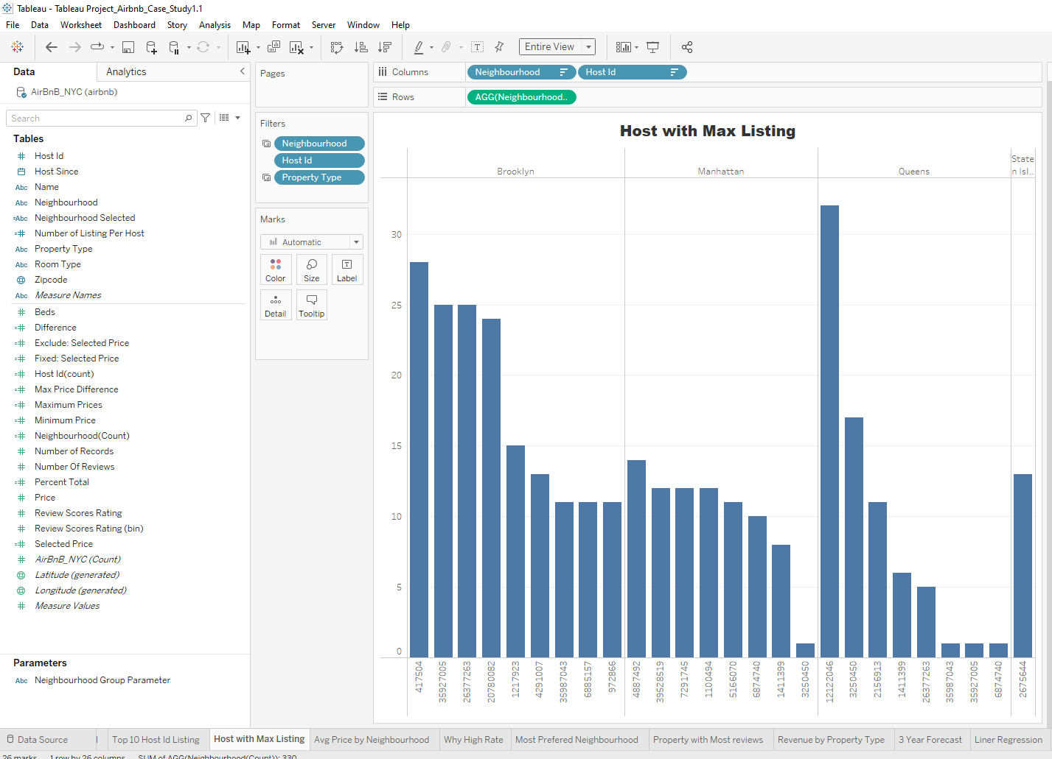
Which neighborhood has the most listing?
Based on Nb of listing: Queens had the most listed based
Based on Host Id: Queens was most listed

Slide 13
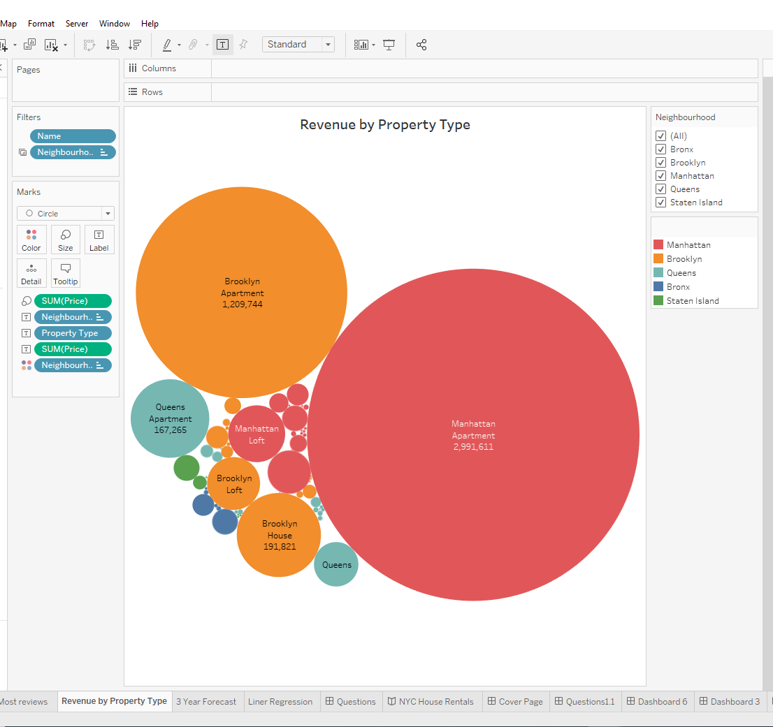
Which property type generated the most revenue?
Based on property type: Most revenue was generated by home/apt in Manhattan neighborhood

Slide 14
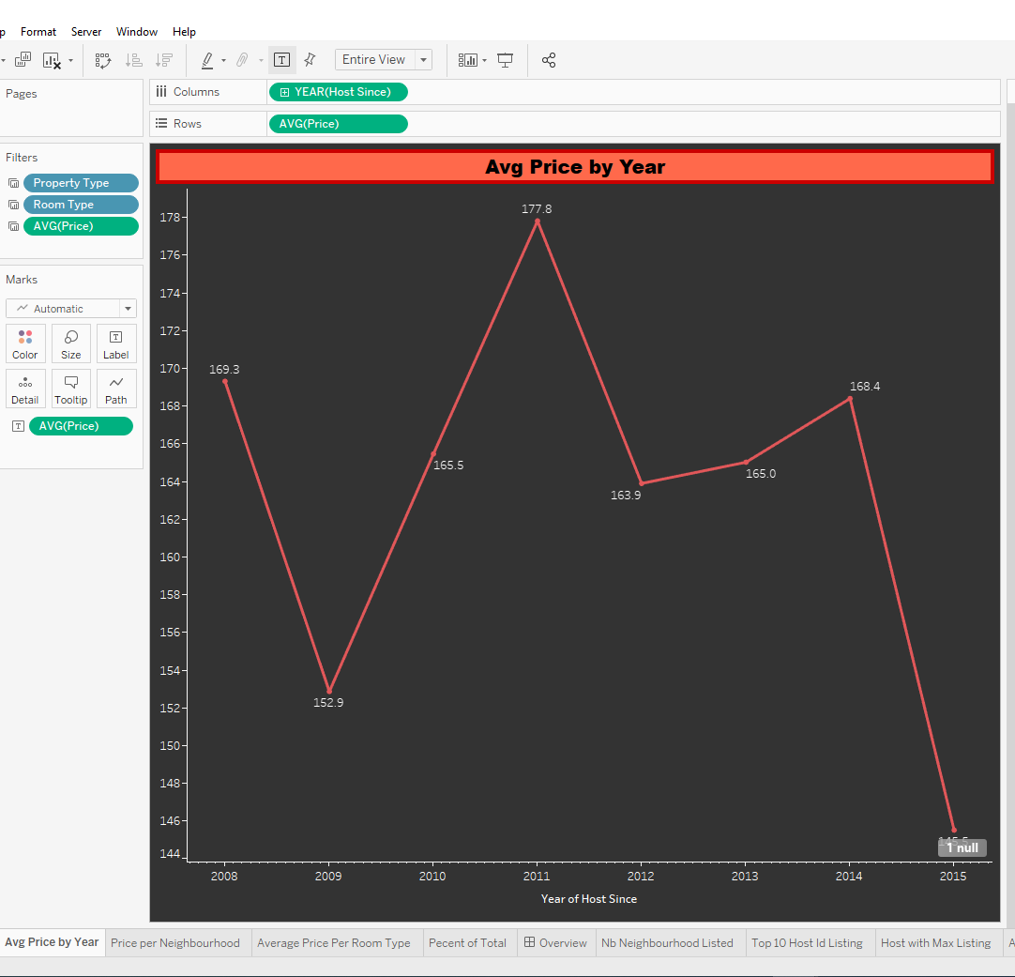
How is the price over the Hosts started hosting guests?
Average price over the past 8 years has been additive in nature

Slide 15
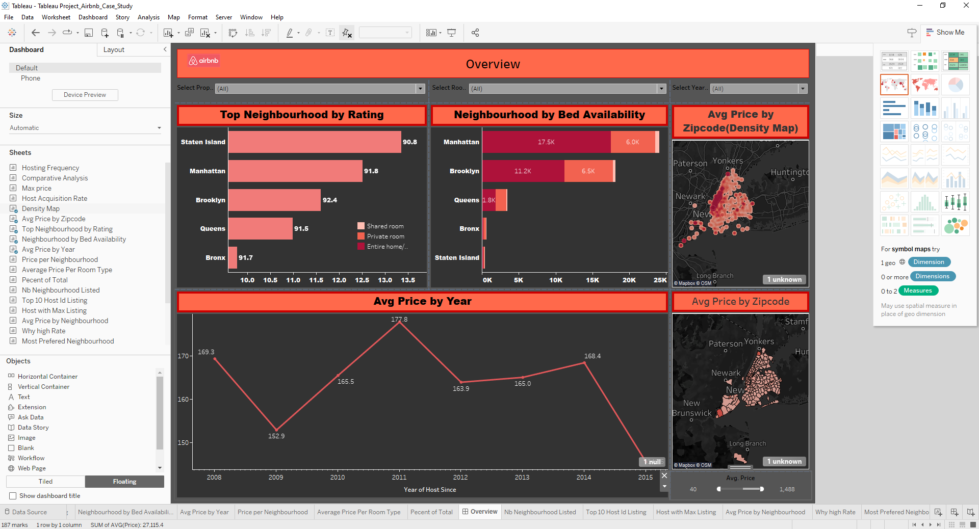
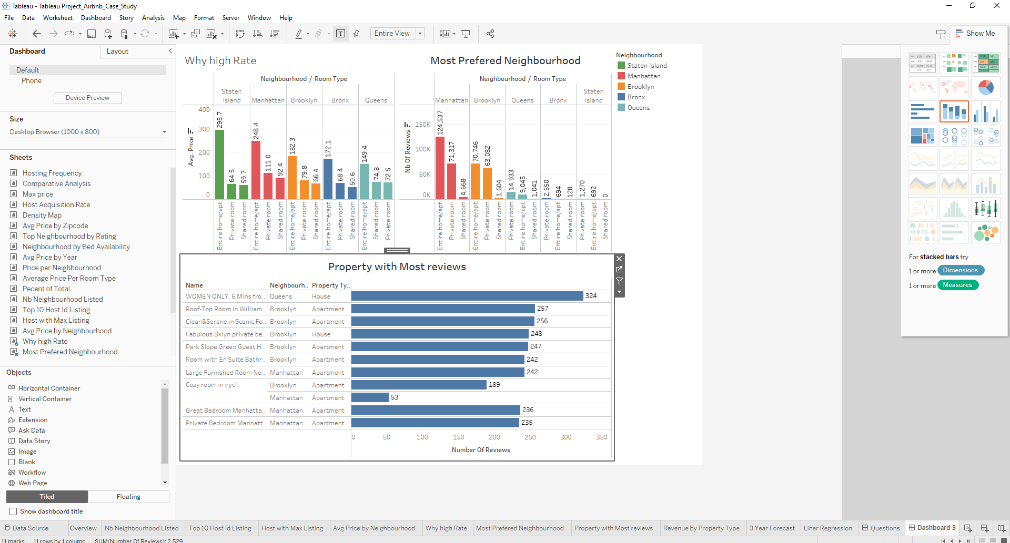
Create and Organize Dashboards
Notes:
Please refer to Tableau views for more details

Slide 16
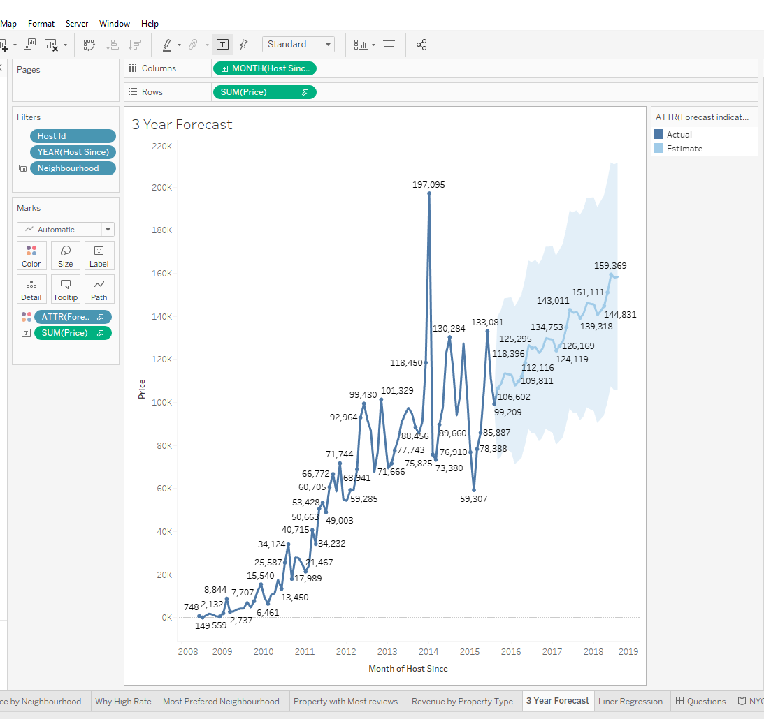
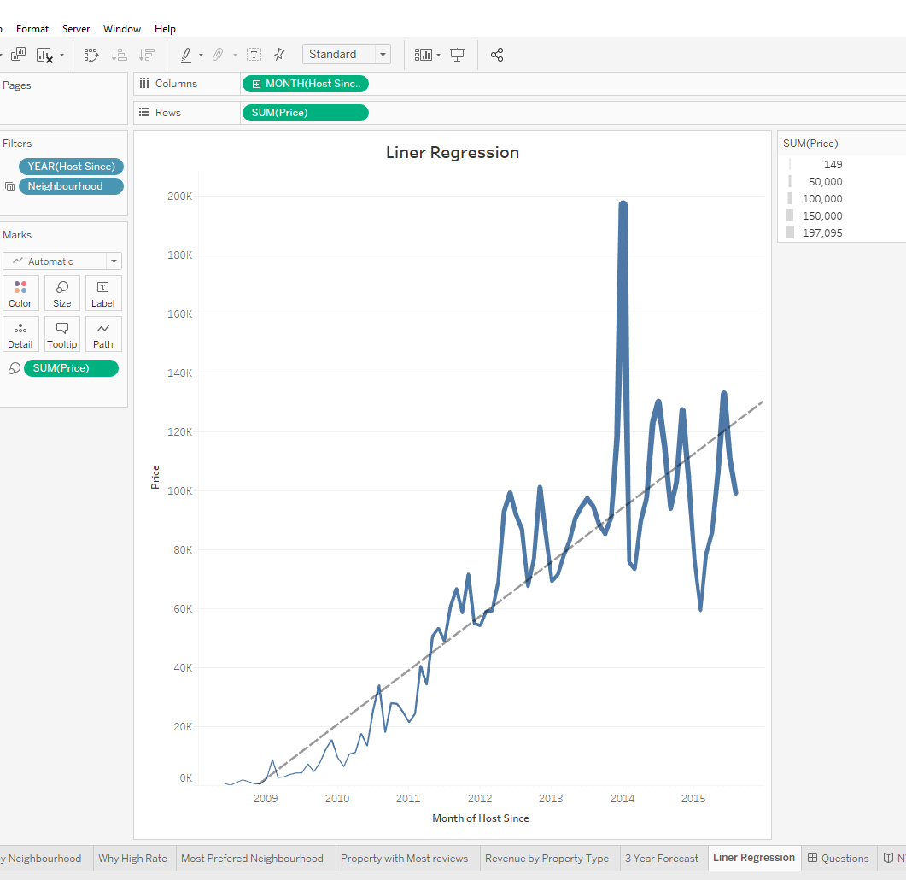
Insight
3 years forecast
Linear regression
Trend analysis reveals the following:
Using the additive model, the confidence band was too wide
Using the multiplicative model, no prediction
Quality: poor
Hence, prediction could not be made due to outliers and issues with the data
Notes:
Please refer to Tableau views for more details

Slide 17
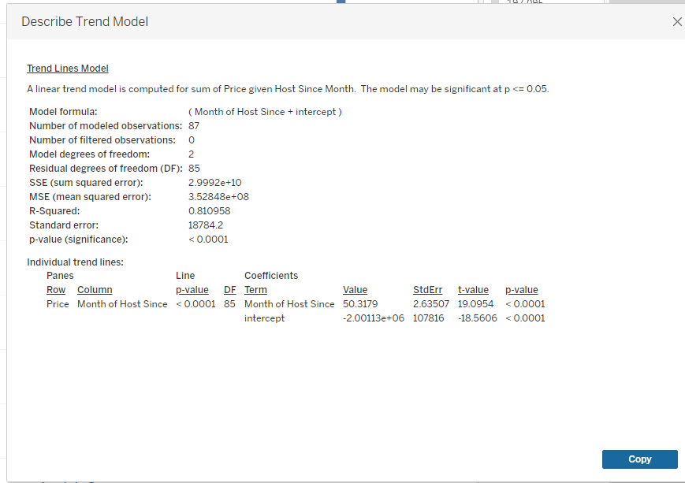
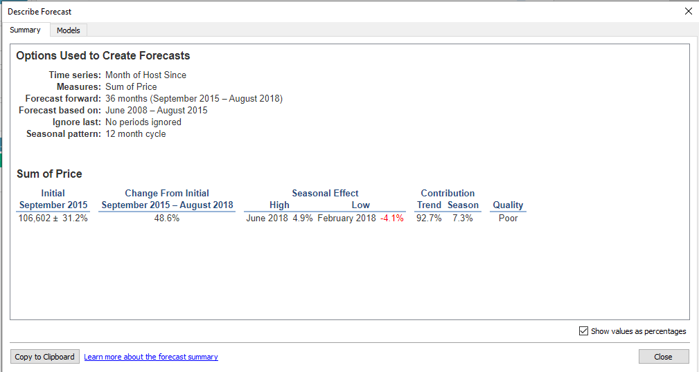
Insight
Linear regression result
3 years forecast result
Notes:
Please refer to Tableau views for more details

Slide 18
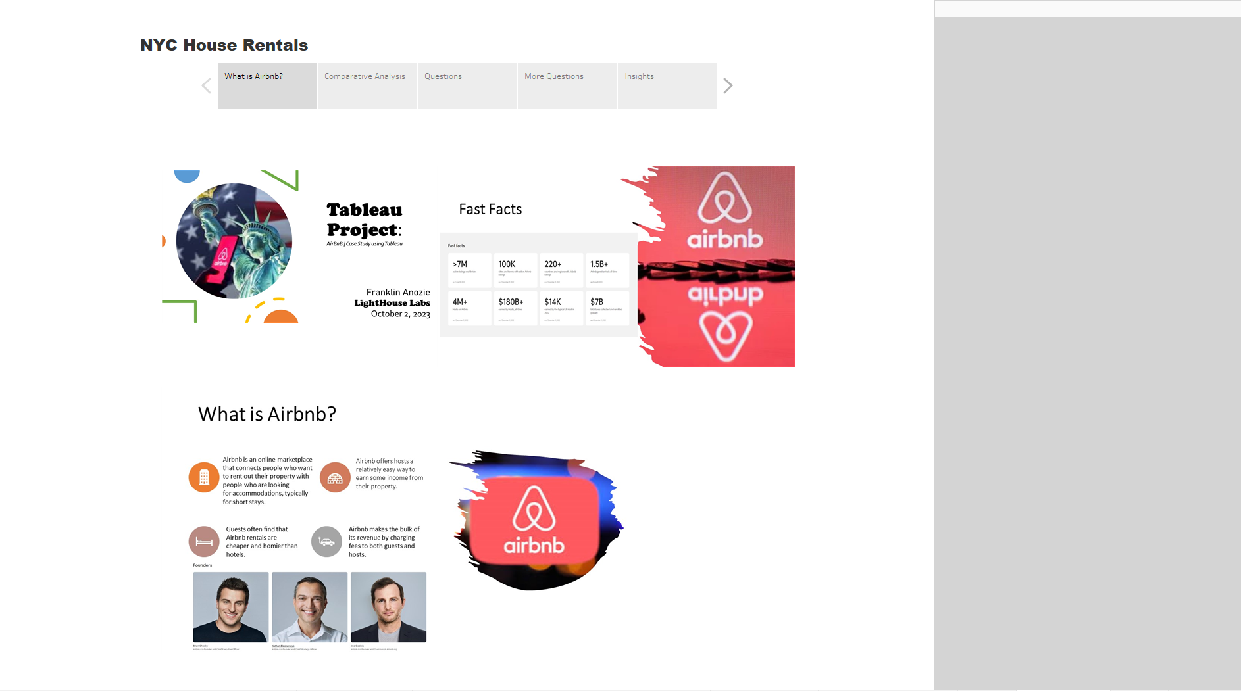
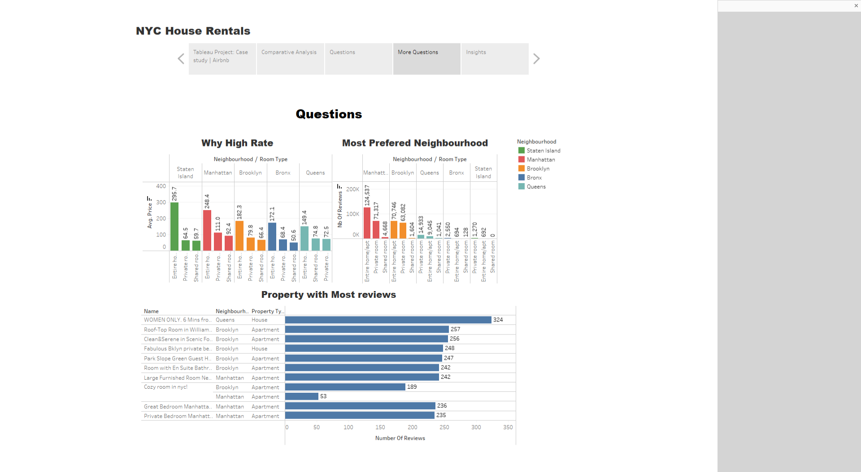
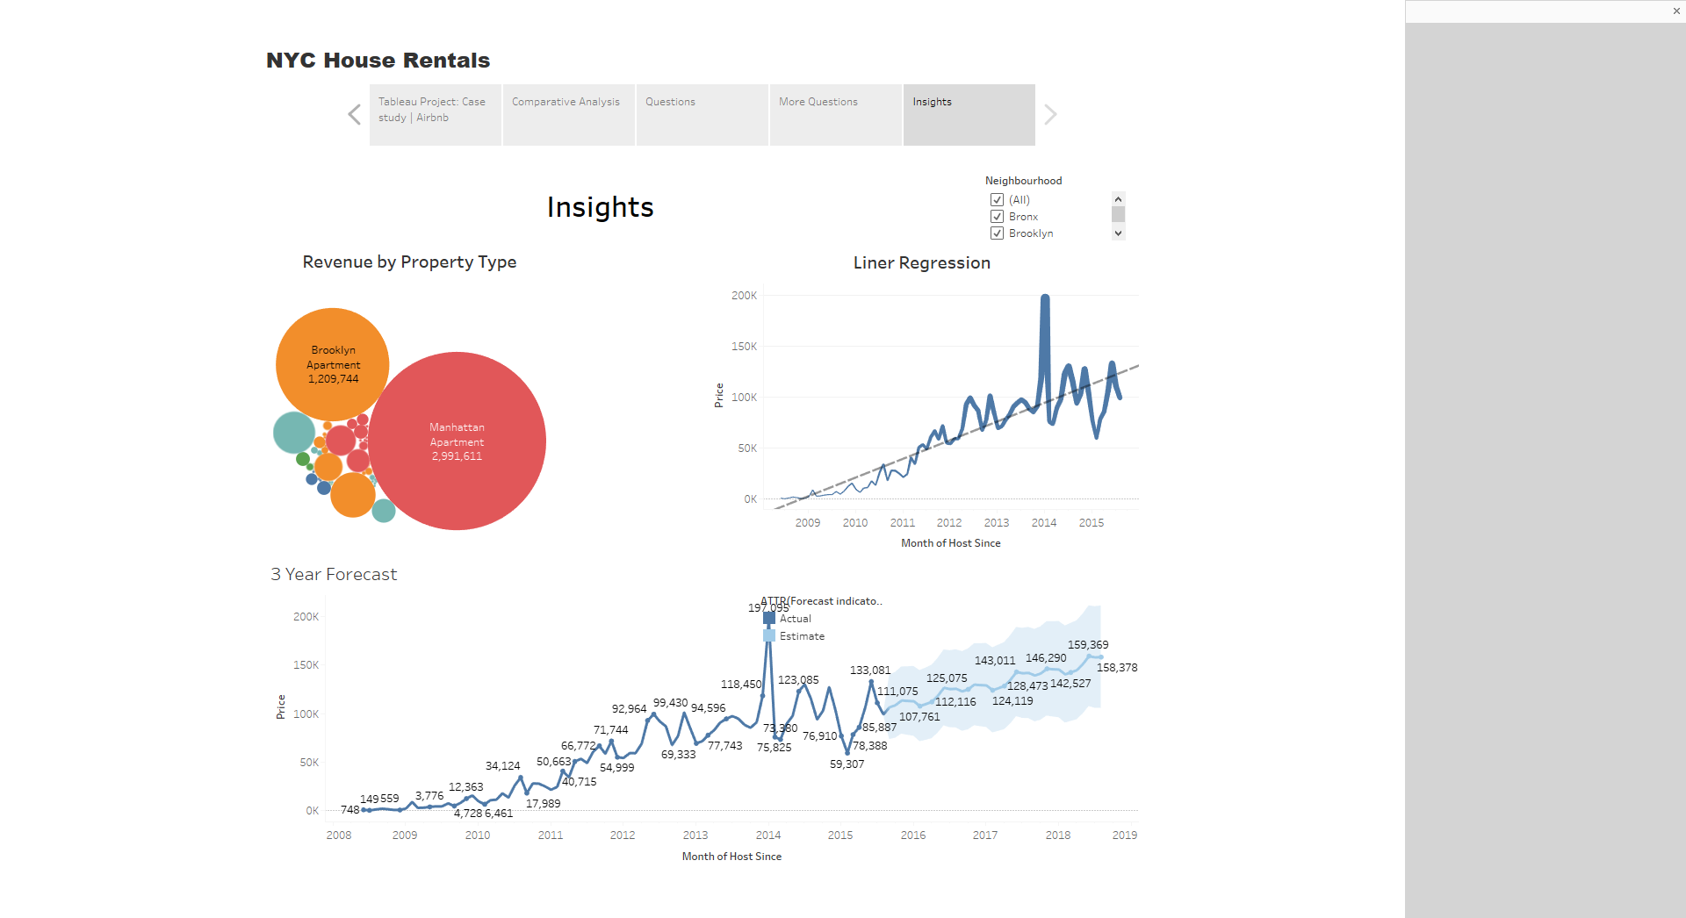
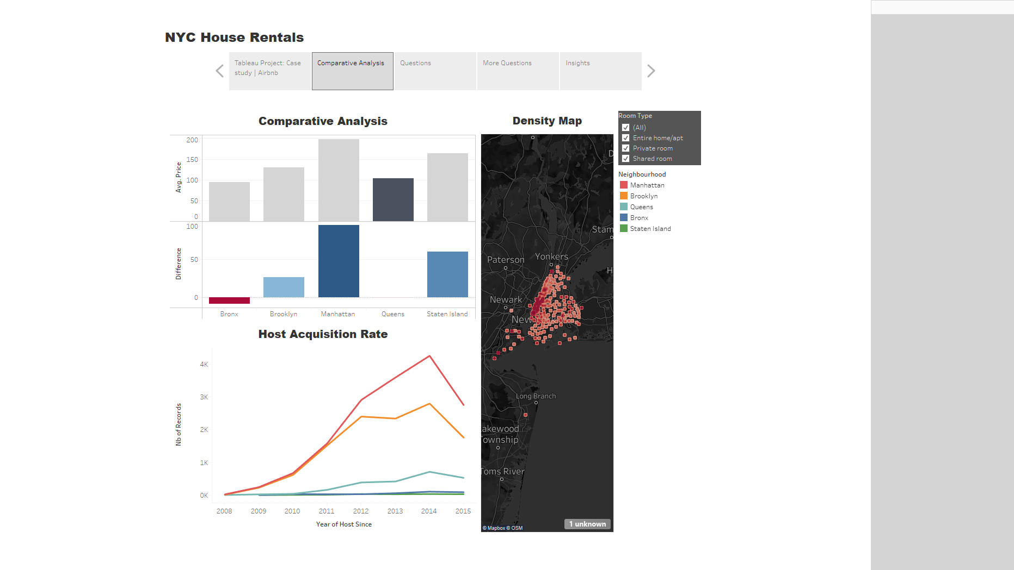
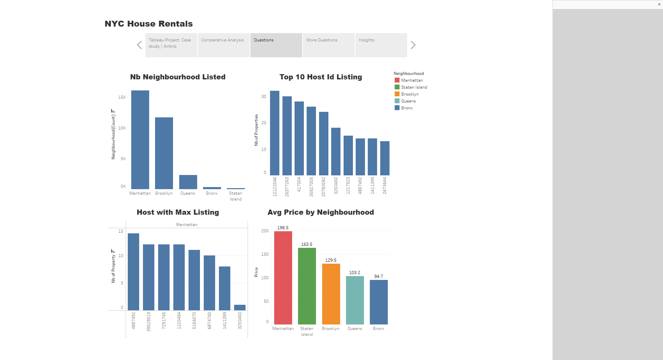
Create Story: NYC House Rentals
Notes:
Please refer to the attached Tableau file on github

